Slide 1
IOT live weather monitoring station using NodeMCU and ESP8266
PRESENTED BY:
170040723
170040749

Slide 2
INTRODUCTION
A weather station is a device that collects data related to the weather & environment using different sensors.
A thermometer to take temperature readings.
A barometer to measure the atmospheric pressure.
A Hygrometer to measure humidity.
A rain sensor to measure rainfall.
We will measure humidity, temperature, Barometric pressure, and rainfall and upload the data to a web server.

Slide 3
COMPONENTS USED:
NodeMCU ESP8266 12E Board.
BMP180 Pressure Sensor.
DHT11 Humidity Temperature Sensor.
Rain Sensor FC37.
4.7K Resistors - 2 .
Breadboard .
Connecting Jumper Wires.

Slide 4
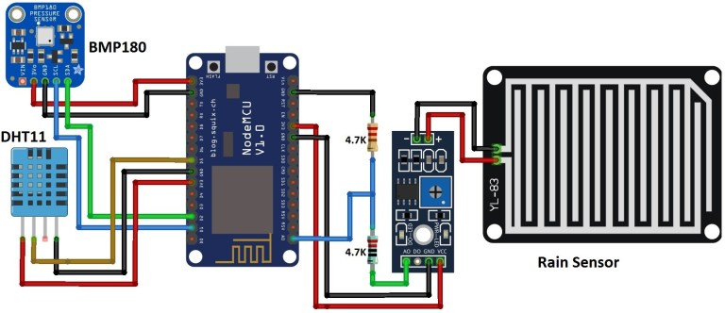
Circuit diagram:

Slide 5
DTH11 Humidity Temperature sensor:
It uses a humidity sensor and a thermistor.
It has three pins: VCC, Data, GND.
Measures surrounding air and spits out data using data pin.

Slide 6
BMP180 Pressure sensor:
Barometric Pressure sensor.
Very high performance.
Smaller in scale.
Ultra low power consumption.

Slide 7
Rain sensor FC37
Better than humidity sensor.
The Wetter the board, more current is passed.
Variable resistor.

Slide 8
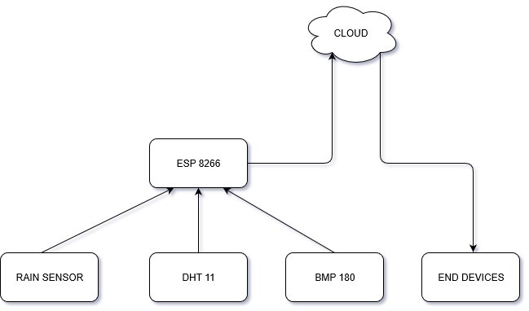
BLOCK DIAGRAM:

Slide 9
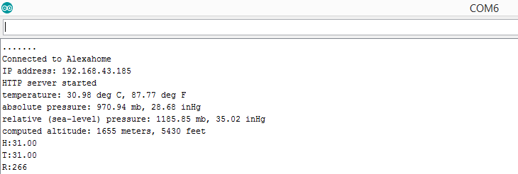
Final view:

Slide 10
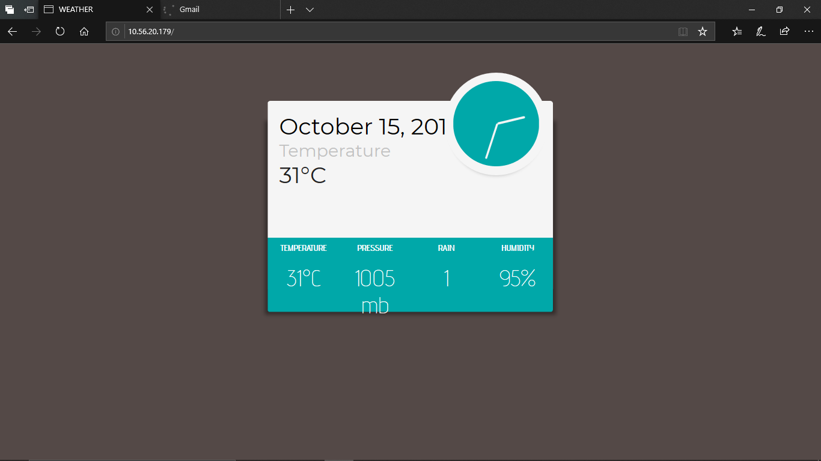

Slide 11
FLEXIBILITY:
IP address connection.
JSON – Human readable transmission.
Rain sensor – analogue, digital.
Communication between several ESP8266.
Automation.

Slide 12
CONCLUSION:
Sharing data in the network.
Web browser interface.
Date, time, sensor data.

